Slide 1
IMDB SCORE PREDICTION
TEAM 7
2031035 RITHIK SUTHAN S

Slide 2
PROBLEM STATEMENT
In this project, we would like to analyze what kind of movies are more successful, in other words, get higher IMDB score.
We also want to show the results of this analysis in an intuitive way by visualizing outcome using ggplot2 in R.
In this project, we take IMDB scores as response variable and focus on operating predictions by analyzing the rest of variables in the IMDB 5000 movie data.
The results can help film companies to understand the secret of generating a commercial success movie.

Slide 3
Data Cleaning
Missing Values:
To find missing values in each column, we use colSums() function to aggregate NA in each column.
colSums(sapply(IMDB, is.na))
Addition of Columns:
To find profit percentage of all the movies
We have gross and budget information. So let’s add two colums: profit and percentage return on investment for further analysis.
IMDB <- IMDB %>%
mutate(profit = gross - budget,
return_on_investment_perc = (profit/budget)*100)

Slide 4

Removal of unnecessary columns:
Is the color of a movie influential?
IMDB <- subset(IMDB, select = -c(color))
More than 96% movies are colored, which indicates that this predictor is nearly constant. Let’s remove this predictor

Slide 5
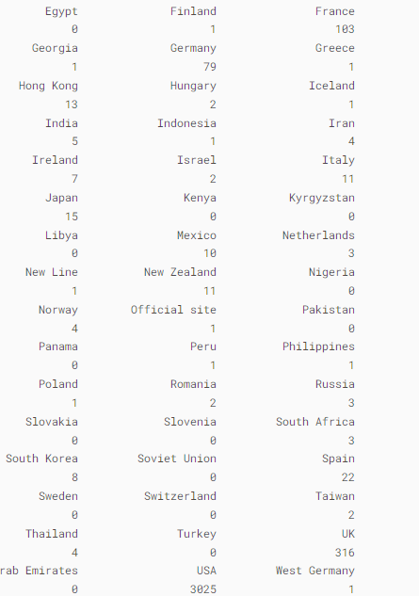
Is language an important factor for imdb score? What about country?
levels(IMDB$country) <- c(levels(IMDB$country), "Others")
IMDB$country[(IMDB$country != 'USA')&(IMDB$country != 'UK')] <- 'Others'
IMDB$country <- factor(IMDB$country)
table(IMDB$country)

Slide 6
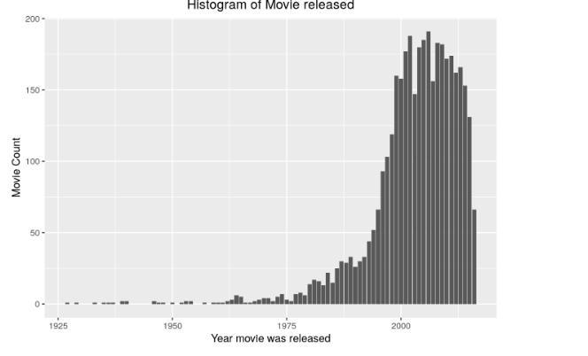
DATA VISUALIZATION:
Histogram of Movie Released:
From the graph, we see there aren’t many records of movies released before 1980. It’s better to remove those records because they might not be representative.

Slide 7
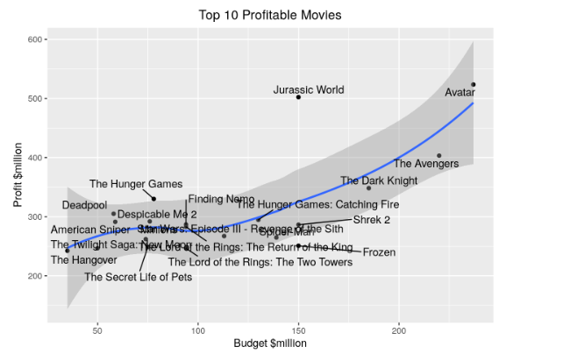
Top 20 movies based on its Profit:

Slide 8
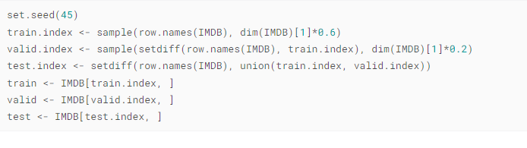
DATA PREPROCESSING:
Here we split data into trainng, validation and test sets with the ratio of 6:2:2.

Slide 9
Implementation of Classification Algorithm:
Classification Tree:
A classification tree is a structural mapping of binary decisions that lead to a decision about the class (interpretation) of an object (such as a pixel).
Although sometimes referred to as a decision tree, it is more properly a type of decision tree that leads to categorical decisions.

Slide 10
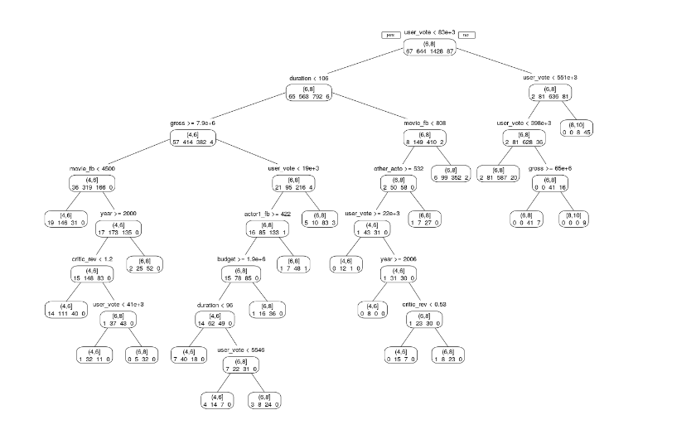

Slide 11
K-Nearest Neighbors:
The k-nearest neighbors algorithm, also known as KNN or k-NN, is a non-parametric, supervised learning classifier, which uses proximity to make classifications or predictions about the grouping of an individual data point.
While it can be used for either regression or classification problems, it is typically used as a classification algorithm, working off the assumption that similar points can be found near one another.

Slide 12
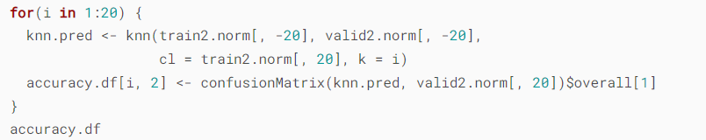
Find the best k
We will set k as 1 to 20, and build 20 different models. We calculate each model’s classification accuracy, and find the best k according to the highest accuracy.
When k = 9, we get the highest accuracy: 0.7142857

Slide 13
Random Forest:
Random Forest is a robust machine learning algorithm that can be used for a variety of tasks including regression and classification.
It is an ensemble method, meaning that a random forest model is made up of a large number of small decision trees, called estimators , which each produce their own predictions.
The random forest model combines the predictions of the estimators to produce a more accurate prediction.

Slide 14
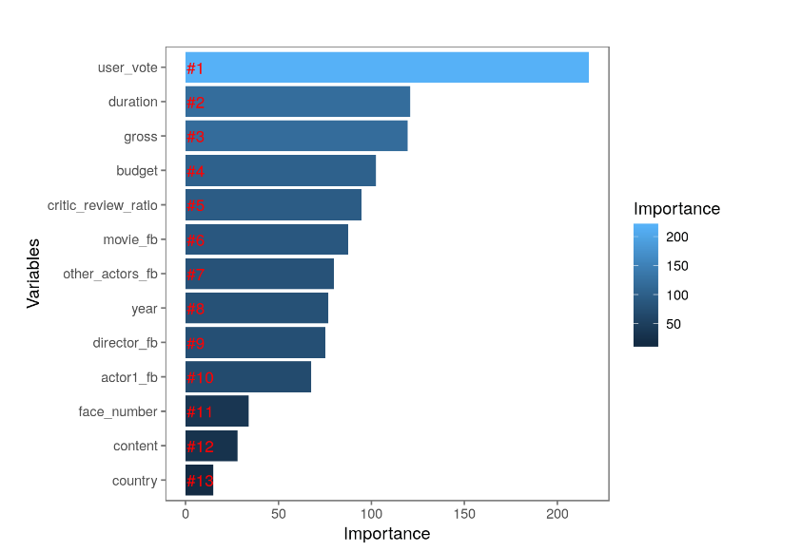
We are finding the relative variable importance by plotting the mean decrease in Gini calculated across all trees.

Slide 15
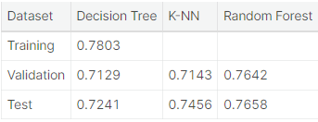
Best Model:

Slide 16
Implementation of Clustering Algorithm:
The clustering algorithm is an unsupervised method, where the input is not a labeled one and problem solving is based on the experience that the algorithm gains out of solving similar problems as a training schedule.
K means Algorithm:
The K-means clustering algorithm computes centroids and repeats until the optimal centroid is found.
It is presumptively known how many clusters there are.
It is also known as the flat clustering algorithm.
The number of clusters found from data by the method is denoted by the letter 'K' in K-means.

Slide 17
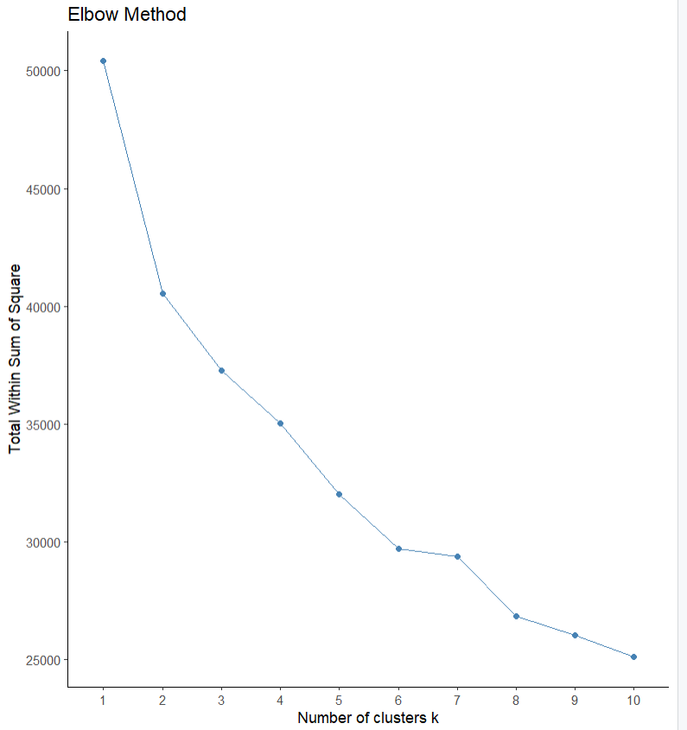
Elbow method:

Slide 18
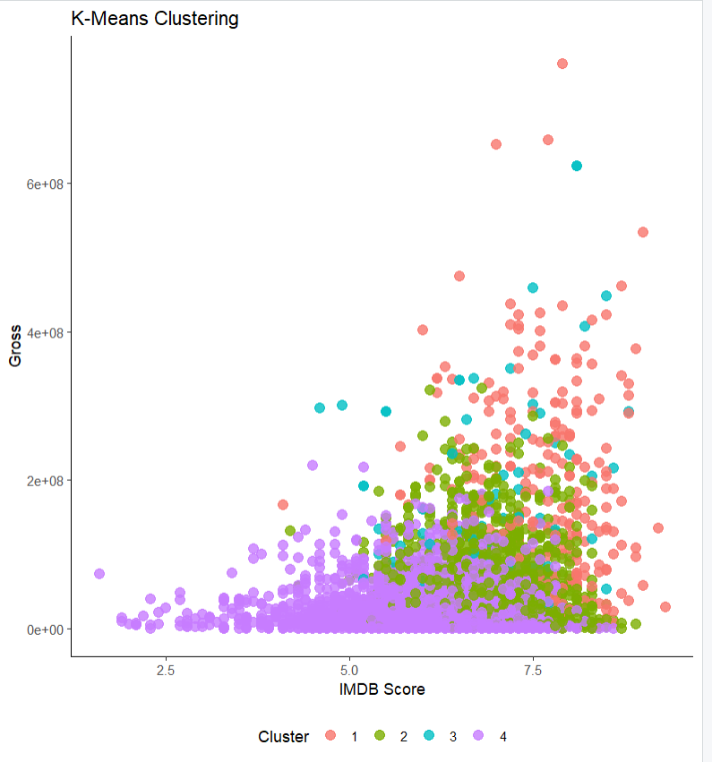
Output:

Slide 19
THANK YOU

